Slide 1
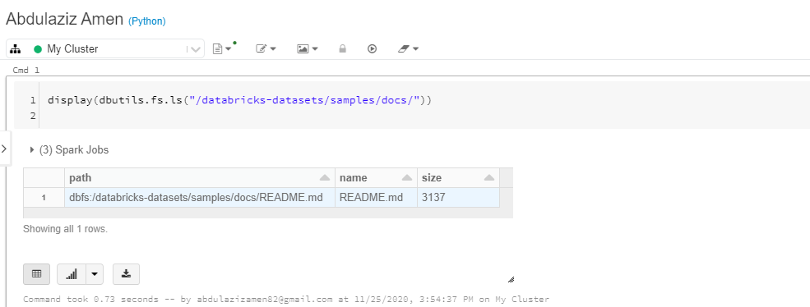
Showing datasets of databricks using display and dbutils functions

Slide 2
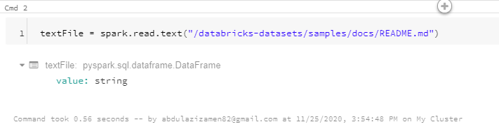
Reading README file and converting it to dataframe

Slide 3
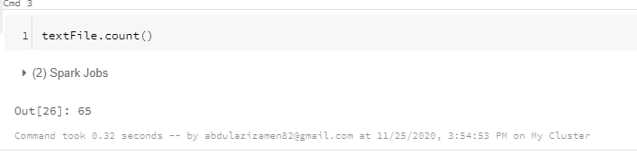
Counting README file

Slide 4
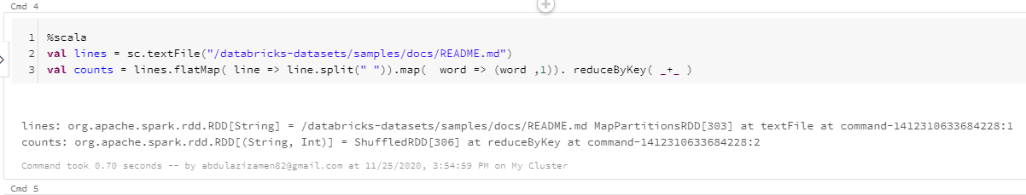
Word counting using flatMap function that works line by line and sent it to map function that works on each word

Slide 5
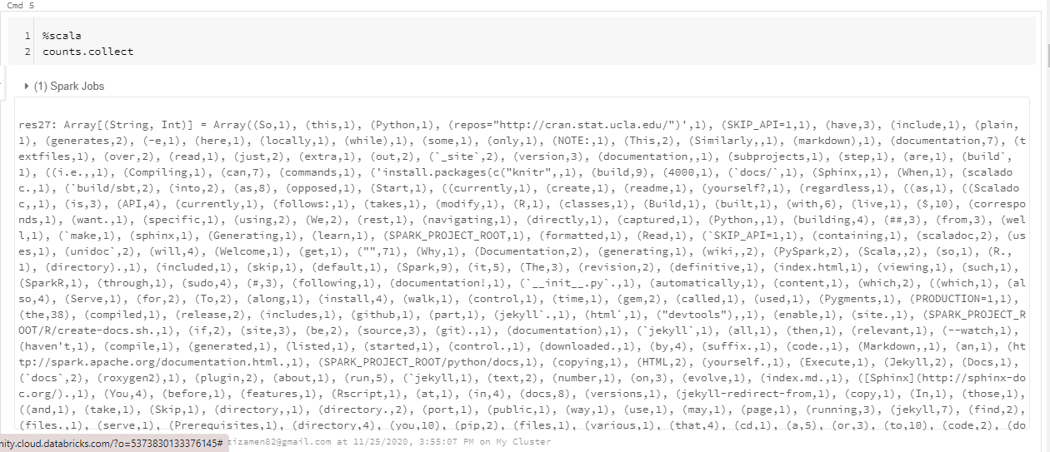

Slide 6
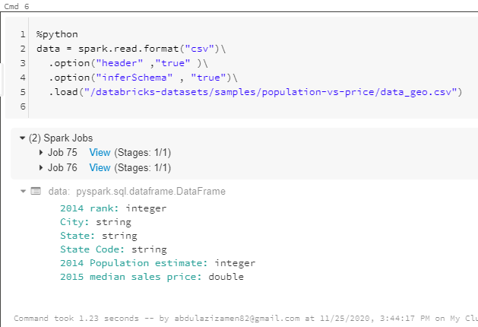
Reading csv file and loading into data variable

Slide 7
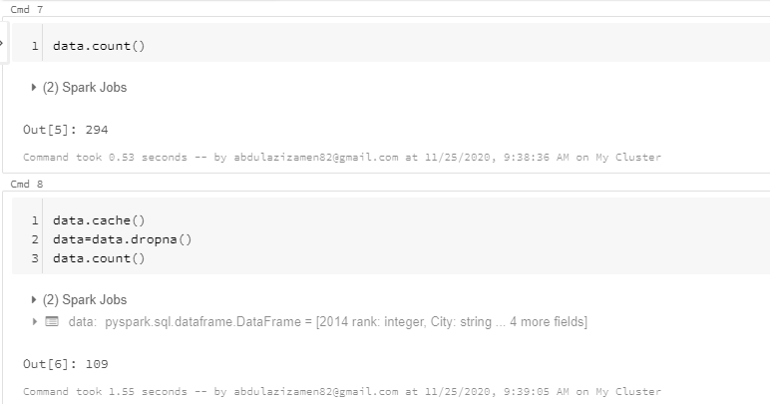
In Cmd 7 - file counting In Cmd 8 – file counting after drop rows with missing values

Slide 8
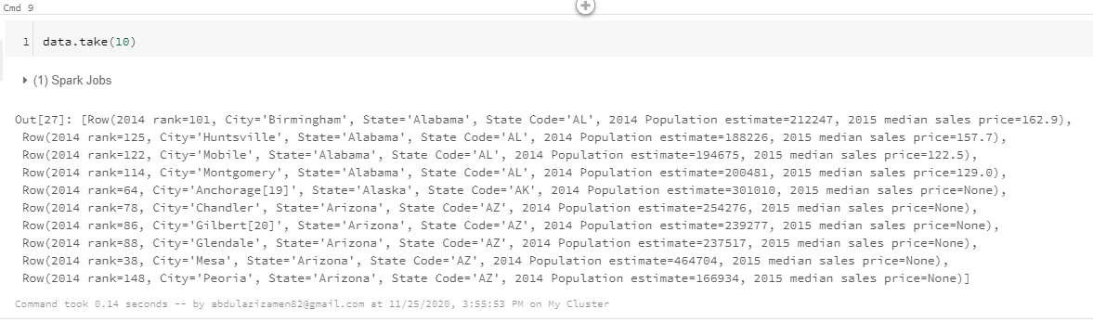
Showing first 10 rows of data

Slide 9
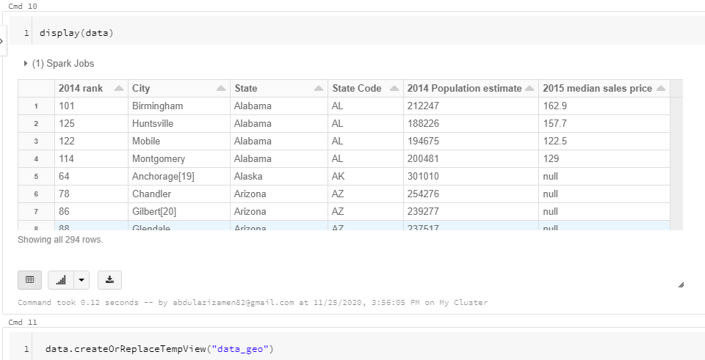
In Cmd 10 - Showing data in table form using display function in Cmd 11 – using (createOrReplace) function to show data in table form as tempview and to query data

Slide 10
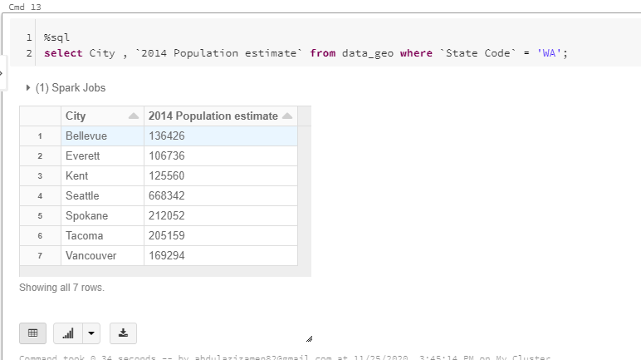
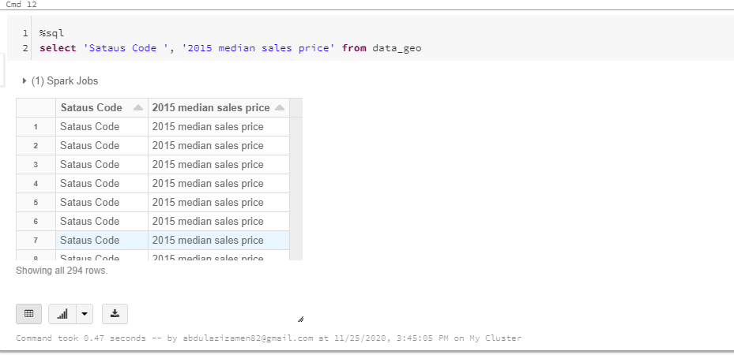
Selecting query from tempview

Slide 11
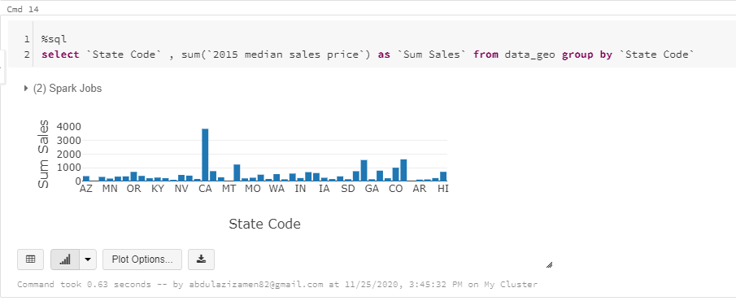
Result visualization using bar chary

Slide 12
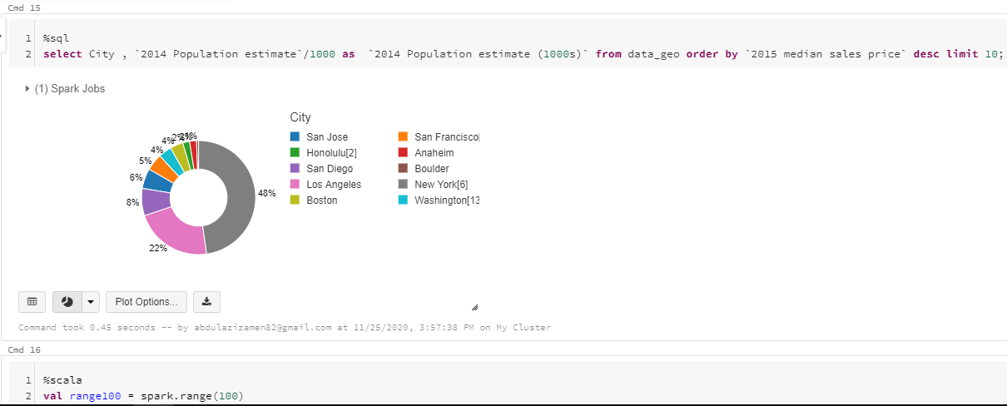
Result visualization using Pie chart

Slide 13
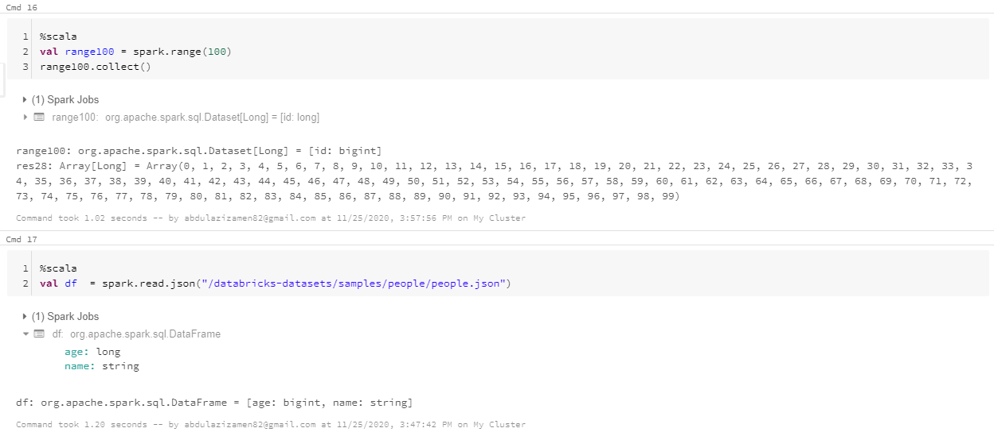
In cmd 16 - Creating array of 100 elements and converting it to dataset In cmd 17 – converting json file to untyped dataframe and found two columns , age with type long and name with type string

Slide 14
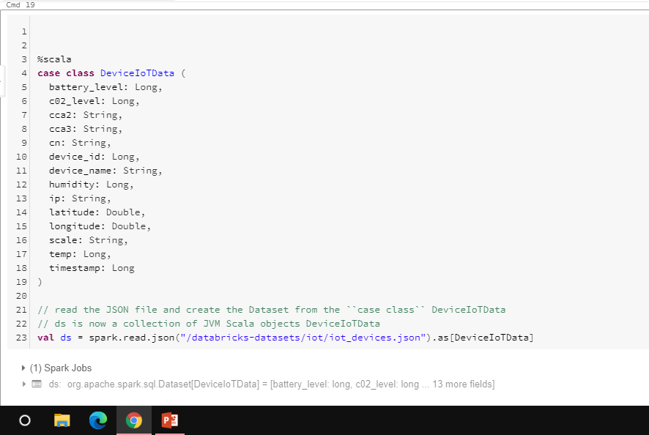
Importing IoTDeviceData from databricks/datasets directory

Slide 15
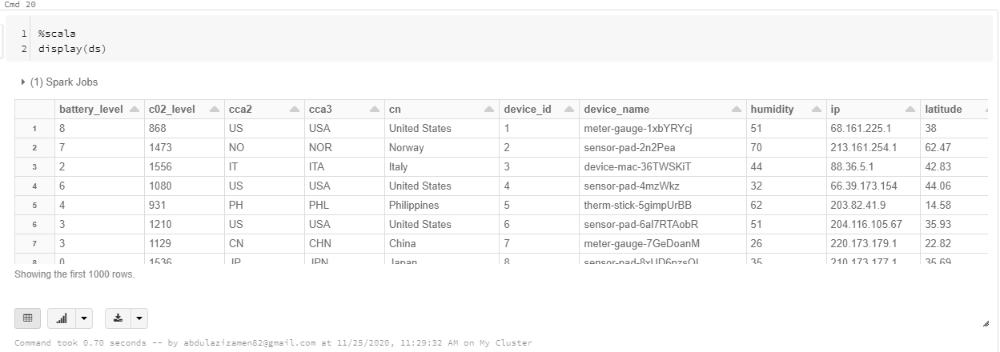
Displaying data

Slide 16
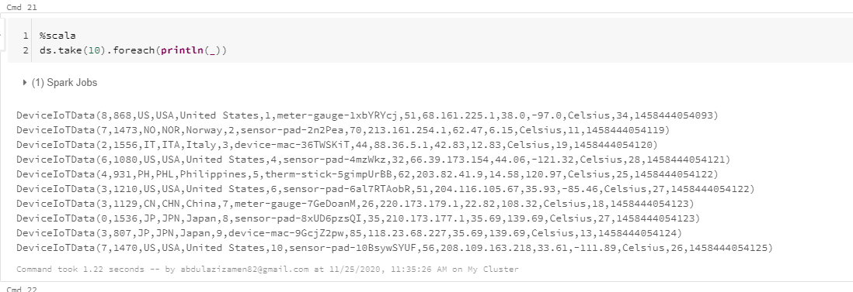
Showing first 10 rows of data

Slide 17
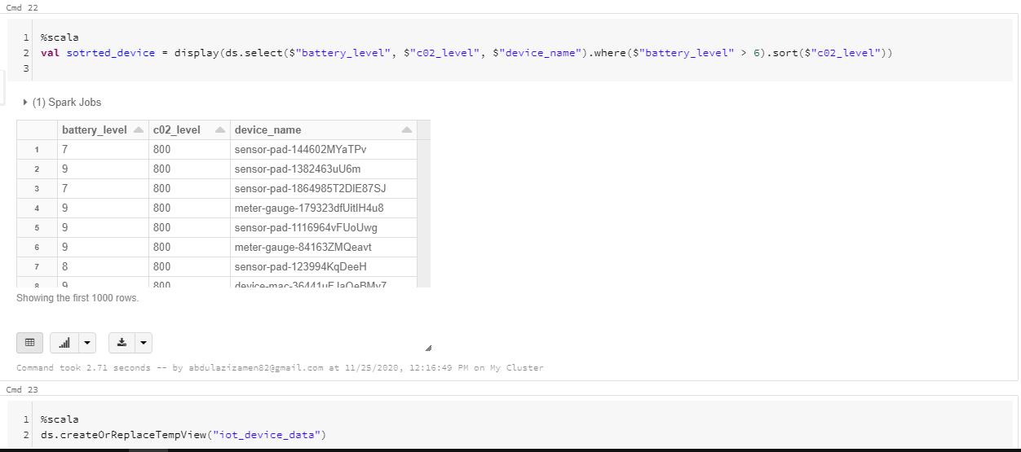
In CMD 23 using (createOrReplace) function to show data in table form as tempview and to query data

Slide 18
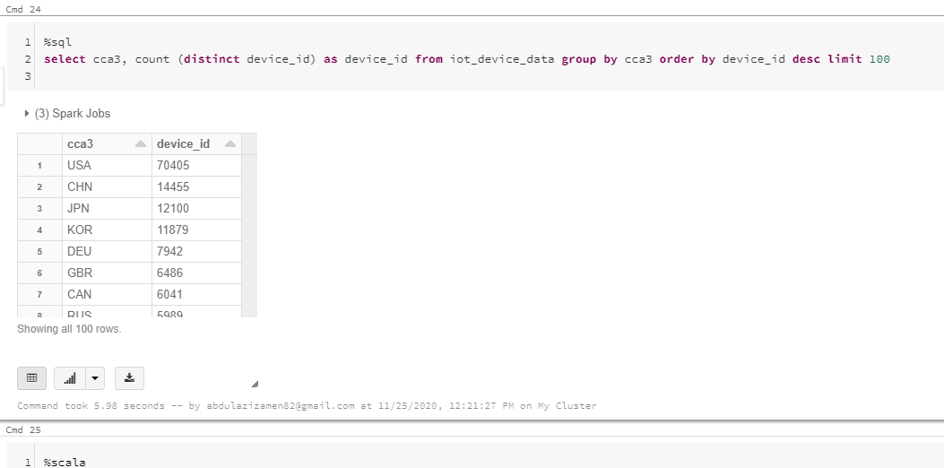

Slide 19
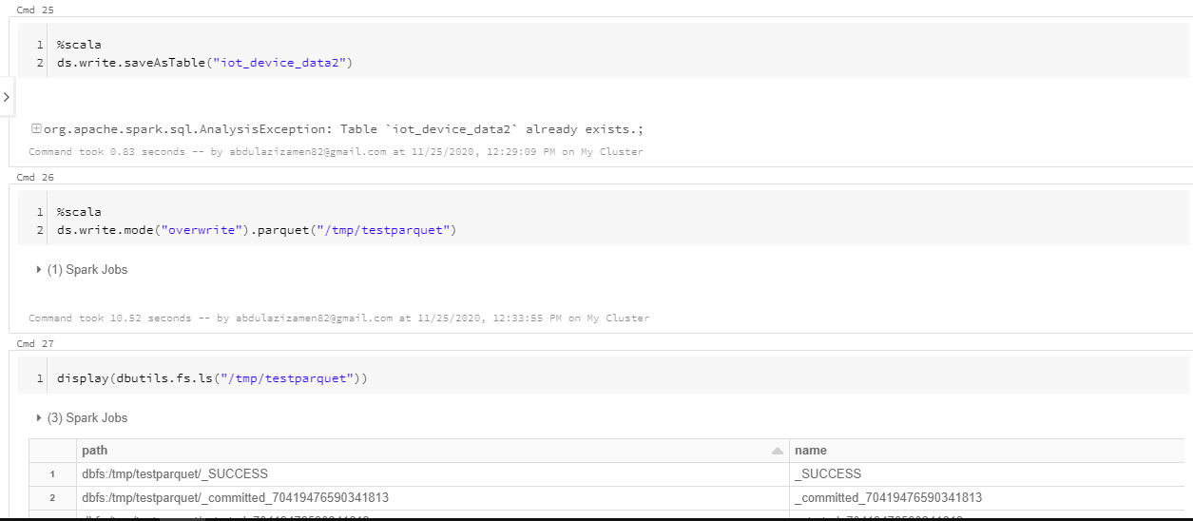
In Cmd 25 – saving my iot_device datset as table in my database in Cmd 26 - Converting my file format to parquet format

Slide 20
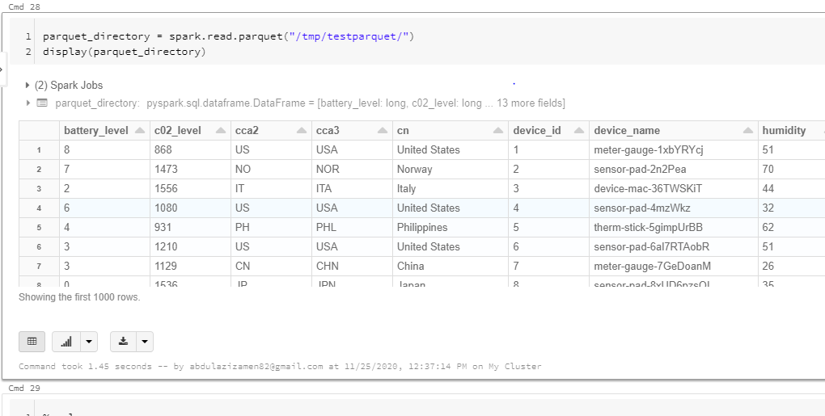

Slide 21
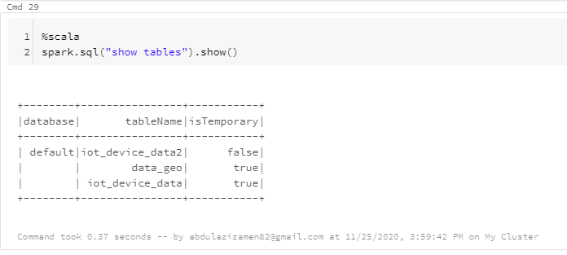
Showing all tables in spark using method spark .sql

